Slide 1
Using World Health Organization & AARP Guidance to Transform DC into an Easier City
in which to Grow Older

Slide 2
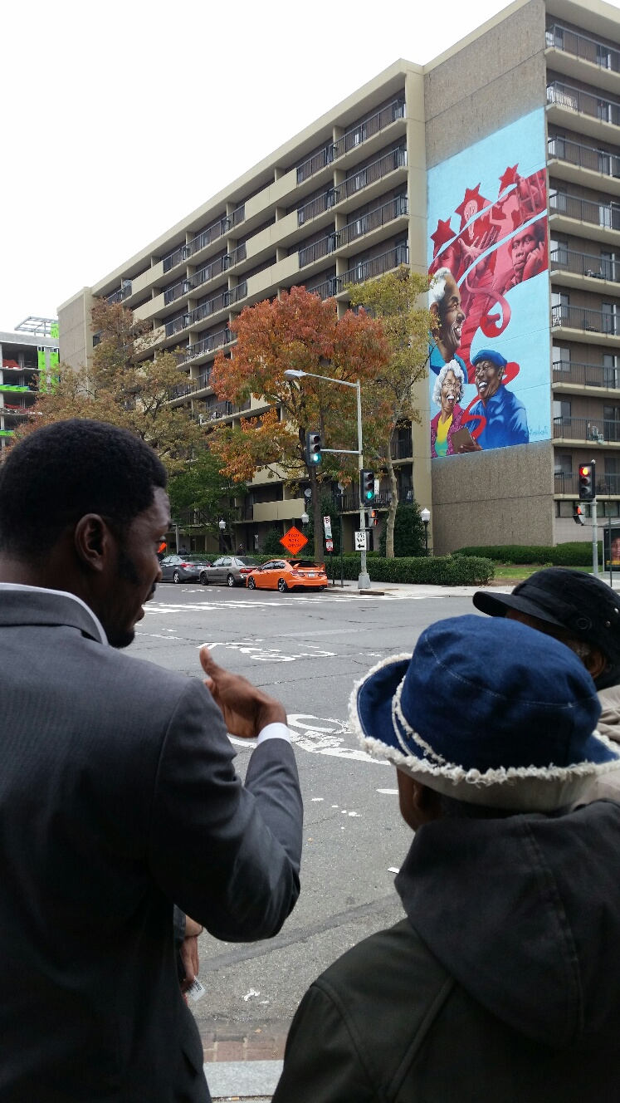
Age-Friendly DC Plan
2018-2023
Built Environment – Outdoor Spaces & Buildings, Transportation, Housing
Changing Attitudes about Growing Older – Social Participation, Respect & Social Inclusion, Civic Participation & Employment, Communication & Information
Lifelong Health & Security – Community Support & Health Services, Emergency Preparedness & Resilience, Abuse, Neglect & Fraud, Financial Security, Public Safety, Lifelong Learning, Caregiving

Slide 3
Age-Friendly Projects with Potential to Make Big a Difference by 2023
Built Environment
Accessory Dwelling Units/Homesharing
Affordable Assisted Living
Vision Zero
Increasing proportion of dedicated bike and bus lanes, accessible buildings/drop-off zones/automatic opening doors
Changing Attitudes about Aging
More 50+ year old Workers, particularly in Long Term Care
Promoting entrepreneurship
Implementation of paid leave for caregivers
Visibility of the contribution of volunteers in DC – State of Volunteerism
2020 Census
Increasing value of 50+ year old students to colleges and universities
Lifelong Health & Security
PACE
Addressing Behavioral Health
Cross-Agency energy around Emergency Preparedness & Resilience
Change to “opting out” instead of “opting in" to retirement savings
Notes:
Here are highlights of initiatives Age-Friendly DC has promoted, supported and publicized.
Note the highlighted aim on which we will focus today.

Slide 5
How can the Department of Employment Services Help Me?
Dr. Unique Morris-Hughes is the Director of the District of Columbia Department of Employment Services (DOES). In her role as State Labor Commissioner, she is directly responsible for more than $150M in local, federal and specific-purpose funds administered by the District of Columbia and the federal government for workforce development programs and training, unemployment compensation, universal paid leave administration and labor standards enforcement along with more than $80M in active capital projects.
Dr. Unique Morris-Hughes

Slide 6
How can the Department of Employment Services Help Me?
Dr. Morris-Hughes told us:
If you want to start a business, the Department of Employment Services can help you. Director, Dr. Unique Morris-Hughes said,
“Go to https//:www.does.gov or just call 202-724-7000. You’ll be assigned to a counselor who will guide you to:
--employment opportunities while you are organizing your start-up.
--skills sharpening education, including tech training for promotion.
--programs that will give you free employees that you can evaluate and then paying yourself, if you have a match.
--becoming a mentor, so you can have apprentices who can learn from you, while working for you.”
Dr. Unique Morris-Hughes

Slide 7
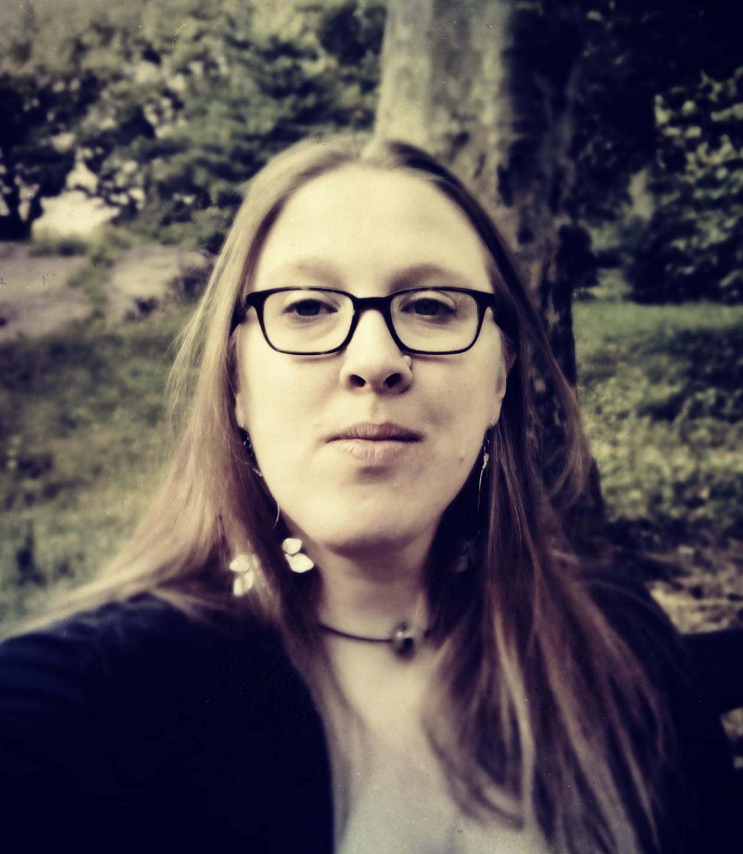
Help from the Office of Small and Local Business Development
Kate Mereand is a career professional working to build and support the small business ecosystem in the District of Columbia. Kate joined the Department of Small and Local Business Development (DSLBD), building out entrepreneurial programs like Aspire, Dream Pitch and more through the creation of the Innovation & Equitable Development (Inno.ED) team.
Kate Mereand

Slide 8
Help from the Office of Small and Local Business Development
Kate Mereand told us, “ Building a Dream requires constant learning.”
“Every business has its own unique ecosystem, relationships among related organizations and people.”
“Seek assistance from others. Talk with 50-100 about your idea.”
“Use the DSLBD Tool Kit.”
”Use mentors.”
Click here to watch the recording of our session on with Kate Mereand.
Kate Mereand

Slide 9
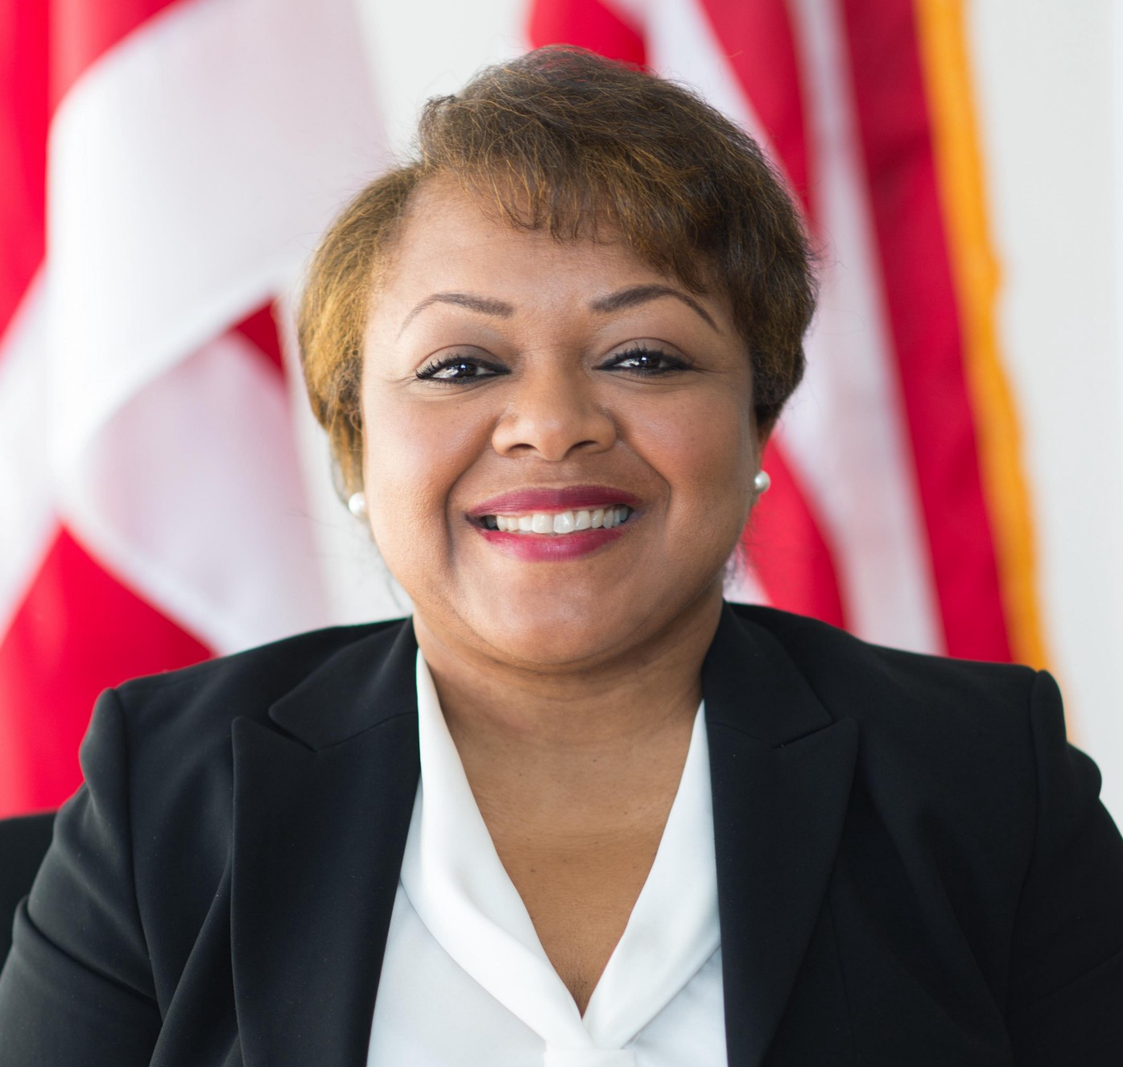
Licensing Made Easy by the Department of Community and Regulatory Affairs
Jacqueline Noisette is the Manager of the District of Columbia’s Department of Consumer and Regulatory Affairs (DCRA) Small Business Resource Center (SBRC). The SBRC has assisted more than 10,000 business owners in obtaining a business license through the regulatory process. Under Mrs. Noisette’s leadership, the SBRC has conducted over 650 free business development workshops. She helped start Build it in DC, where over 2500 presenters and attendees participated in business development sessions designed to educate attendees of new processes, ask questions and network.
Jacqueline Noisette

Slide 10
Licensing Made Easy by the Department of Community and Regulatory Affairs
Jacqueline Noisette told us, “Come to us early, when you have your business vision.”
“You need to get the RIGHT license before you get started.”
”You will get to know us by name.”
My colleagues and I will also lead you through registering with the Office of Tax and Revenue…keep you out of trouble later.”
”And we can lead you to funding opportunities.”
Click here to watch the recording of our session with Jacqueline Noisette.
Jacqueline Noisette

Slide 11
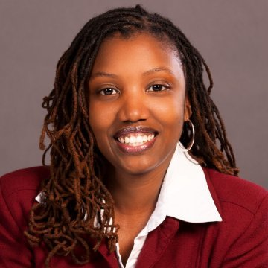
Funding Assistance
from the Office of the Deputy Mayor of Planning and Economic Development
Sybongile Cook is the Director of Business Development and Strategy in the Office of the Deputy Mayor for Planning & Economic Development (DMPED). Since 2009, Sybongile had held multiple roles within the Executive Office of the Mayor of the District of Columbia. Her leadership as a Program Director with the DC Department of Insurance, Banking, and Securities (DISB) expanded the District’s Bank on DC Program. Through her service as a member of the Mayor’s Financial Literacy Council, Sybongile continues to support financial inclusion efforts through creative, innovative, and sustainable programs that promotes the financial health and well-being of District residents.
For several years, Sybongile served as the Director of Great Streets and Retail at DMPED. Her work supported the catalytic development of commercial corridors and neighborhoods through the investment of $30 million of grants to small businesses, real estate development projects, and initiative to bring local grocers to food insecure communities. Prior to her returning to DMPED in her current role, Sybongile launched the Office of Talent & Client Services with the Department of Employment Services and served as the Associate Director.
Sybongile Cook

Slide 12
Funding Assistance
from the Office of the Deputy Mayor of Planning and Economic Development
Sybongile Cook said, “There are lots of funding sources for entrepreneurs to start new businesses or expand.”
She warned, “Be ready, so you don’t have to get ready.” She told us about available grant sources, then added, “Grant sources invest in businesses, that know their business.”
”Over 90% of DC businesses are independently owned.”
“The Deputy Mayor of Planning and Economic Development (DMPED) loves pop-up businesses.”
Cook repeated what we have heard from other entrepreneurship speakers this week, “Find a mentor.”
Click here to view Sybongile’s presentation.
Sybongile Cook

Slide 13
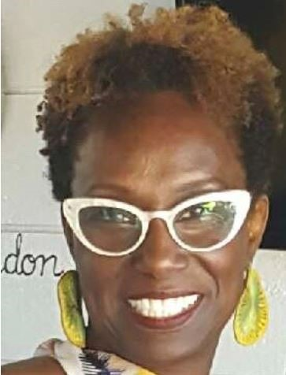
AARP Can Make a Difference for Entrepreneurs
Felicia Brown, Senior Advisor, leads AARP’s Small Business Initiative that promotes and amplifies entrepreneurship for older Americans. She leads the development of educational resources, programming, strategic sponsorships, and leads national convenings. Ms. Brown has over 20 years’ experience developing and managing programs that address the needs of the community.
Click here to view Felicia’s presentation.
Felicia Brown

